Slide 1
Three Signals,
One Story
A Practitioner's Guide to OpenTelemetry on the JVM (Spring Boot Edition)
Robert Sedor - Chief Architect · Paychex · 5 May 2026
https://github.com/patterncatalyst/otel-observability-demos
Notes:
Open with the dots. The three signals — traces, metrics, logs — are the canonical taxonomy of observability. Most observability tooling treats them as separate problems. This talk argues they're one problem, and OpenTelemetry is the unification. Quick intro: name, role, why I care about observability cost (not just observability). Energy: warm, conversational. We have a lot to cover; don't open slowly. Time check at this slide: 0:00 / 35 min.

Slide 2
Why Unified Observability?
Symptoms today
OpenTelemetry promises
What we'll prove
Fragmented tooling per signal
Vendor lock-in for each layer
Trace IDs don't reach the logs
Cardinality bombs in production
GC pauses you only see post-mortem
One vendor-neutral protocol (OTLP)
Auto-instrumentation across libraries
Cross-signal correlation by trace_id
Pluggable processing in the Collector
Consistent semantic conventions
All three signals, one trace_id
Cardinality is taming, not magic
Tail sampling keeps the interesting
GC choice has visible operational shape
Cold start: agent vs SDK is real
Three Signals, One Story
2
Notes:
Three columns: the problem, the pitch, the proof. Don't read every bullet. Pick one from each column to anchor: "trace IDs don't reach the logs" (left) → "cross-signal correlation by trace_id" (middle) → "all three signals, one trace_id" (right). That's the throughline of the whole talk. OpenTelemetry's promises are mostly true. The practitioner's question is: at what cost? That's what we'll measure. [OPTIONAL: insert real-world story here — an outage you've seen where signals didn't correlate. 30s anecdote.]
History lesson
There’s no free lunch
All architecture decisions are least worst choice
There’s nothing we cannot make worse
All management is risk management Time: ~2 min.

Slide 3
Five Demos, The Three Signals
Each demo runs end-to-end on a single laptop. Code on GitHub.
01
Three Signals, One Story
trace_id flows across traces, metrics, logs
02
The Cardinality Bomb
when labels explode and what to do about it
03
Tail Sampling
keep what's interesting, discard the rest
04
JVM Metrics & GC Stories
Shenandoah, G1, ZGC: each has visible shape
05
Cold Start: Frameworks Compared
Spring Boot 4 vs Quarkus, same JDK + Leyden
Three Signals, One Story
3
https://github.com/patterncatalyst/otel-observability-demos
Notes:
Roadmap. Don't read all five — gesture down the list and call out: "this builds. We'll start with the foundation, the trace_id flowing through everything, and end somewhere most observability talks don't go: measuring what observability actually costs at startup." Demos 01-04 are about correctness — making observability work. Demo 05 is about cost — what you pay for the work. Reproducibility commitment: all five demos run on a laptop with podman. No cloud account, no credentials, no kubernetes cluster. The full Grafana/Tempo/Mimir/Loki/Collector stack is one container. [OPTIONAL: show GitHub repo URL on screen briefly] Time: ~3 min.

Slide 4
The Three Signals
Traces
Metrics
Logs
Causal chains across services
Aggregated time-series counters
Discrete events with context
Hello → User Service → DB
http_requests_total{status=200}
INFO HikariPool started
Strength
Strength
Strength
Find the bottleneck, see latency
Cheap to store, easy to alert
Highest fidelity, lowest skill bar
Watch out
Watch out
Watch out
Sampling is essential at scale
Cardinality bombs are real
Volume explodes; storage costs
Three Signals, One Story
4
Notes:
Two minutes here. Brief but make sure each color sticks — purple traces, amber metrics, cyan logs. These colors recur across the whole deck and on the dashboards we'll see in the demos. Each signal has a strength and a failure mode: - Traces are amazing for finding bottlenecks but you can't keep all of them. Sampling is mandatory. - Metrics are cheap and great for alerts, but adding the wrong label to a metric can take down your TSDB. Demo 02 is the cardinality bomb. - Logs have the highest fidelity but the volume can crush your storage budget. What we want is the strengths of all three correlated by one trace_id, with the cost trade-offs explicit. Time: ~5 min.

Slide 5
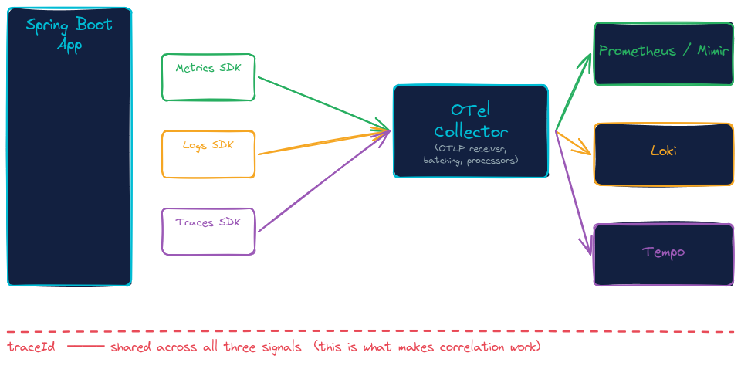
OpenTelemetry: The Unification Layer
One protocol. One SDK. Three signals — preserved, correlated, vendor-neutral.
It's the protocol that matters, not the library used.
Spring Boot 4 (Nov 2025) ships a native OpenTelemetry SDK starter — no agent required.
Three Signals, One Story
5
Notes:
Walk left to right. The application doesn't change shape; it emits OTLP. From there, instrumentation choices vary: a Java agent that rewrites bytecode at startup, or an SDK linked into the app at compile time. Both produce OTLP. OTLP is HTTP/protobuf or gRPC, port 4318 by convention. Protocol-level standardization is what makes vendor neutrality real — you can swap Tempo for Jaeger, Mimir for Cortex, Loki for Elasticsearch, without touching the application. The Collector is the underrated piece. It's where you do filtering, sampling, aggregation, redaction, routing, format translation. Demo 02 and Demo 03 both live in the Collector. Important context for the rest of the talk: as of November 2025, Spring Boot 4 ships a native OpenTelemetry starter. You no longer need the Java agent for Spring Boot apps — there's a real SDK alternative now. Demo 05 measures both. Time: ~7 min.

Slide 6
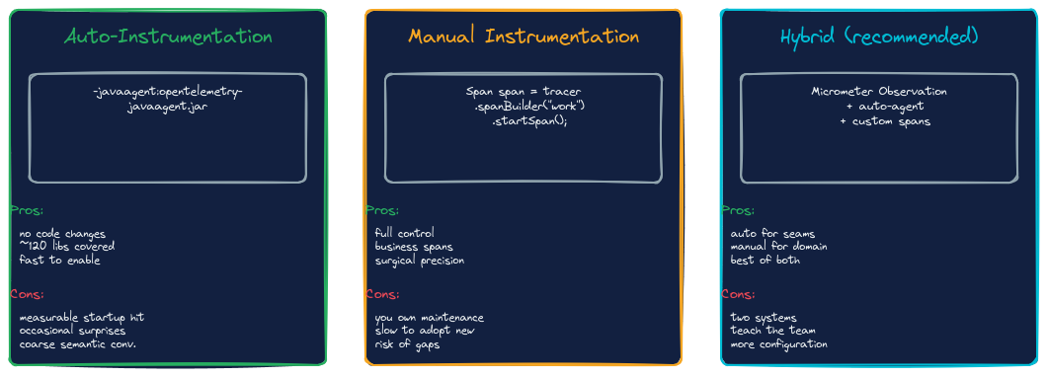
OpenTelemetry: Three Ways to Instrument
One protocol. One SDK. Three signals — preserved, correlated, vendor-neutral.
Three Signals, One Story
5
Notes:
Three columns. Read the headers first — auto, manual, hybrid — and let the audience scan the pros and cons before you commit to a stance.
Auto-instrumentation is the OpenTelemetry javaagent. One JVM flag, around 120 libraries instrumented automatically — Tomcat, Spring MVC, Hibernate, Kafka, JDBC. The trade-off is a measurable startup cost. We'll quantify it for one specific workload in Demo 05.
Manual instrumentation gives you full control. You write the spans, you name them, you pick the attributes. Best for business-domain logic where the framework can't read your intent. Cost is ownership — every span is a thing you maintain.
Hybrid is what most production teams converge on: agent for the framework seams, manual for the domain logic. The diagram calls out Micrometer Observation as Spring Boot's specific glue layer; Quarkus has an equivalent built into its extensions. Two systems, more configuration, but it's where the value is.
Time: ~6 min (1 min for this slide).

Slide 7
The Reference Stack
Same stack across all 5 demos. One Grafana, three signal backends.
Tempo
Trace storage backend
How to access
Grafana UI
localhost:300X
OTLP endpoint
localhost:443XX
Image
grafana/otel-lgtm
Mimir
Prometheus-compatible TSDB
Loki
Log aggregation engine
Grafana
Unified UI for all three signals
Collector
OTLP ingest, processing, routing
Three Signals, One Story
6
Notes:
Stack overview. Grafana's `otel-lgtm` image is the underrated hero of this talk — Grafana plus Loki, Grafana plus Tempo, Grafana plus Mimir, all bundled. One container, ~600 MB. Each demo runs in its own compose file with its own port range (3005, 3006, etc.) so I can leave one demo running while bringing up the next. If anyone in the audience wants to follow along: clone the repo, `cd demo-01-three-signals`, `./demo.sh`. That's the entire on-ramp. [SCREENSHOT placeholder: Grafana home page with the three datasources visible — Tempo, Mimir, Loki — to anchor the visual before we go live.] Time: ~9 min. (Foundation done. Now the demos.)

Slide 8
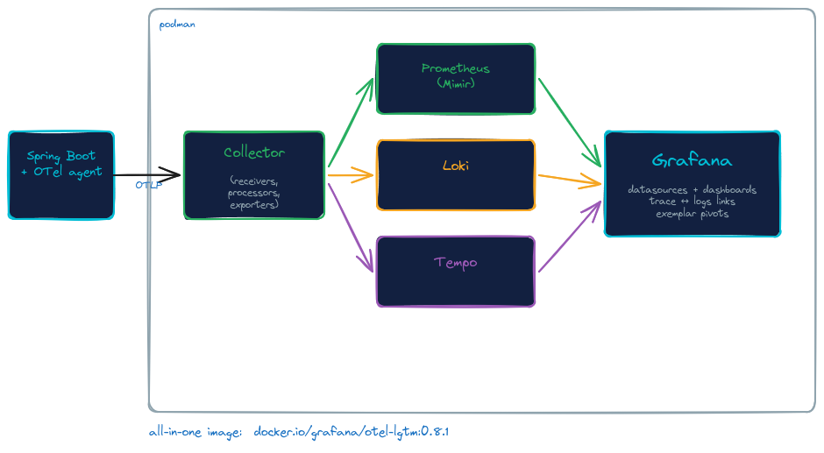
The Reference Stack
Same stack across all 5 demos. One Grafana, three signal backends.
Three Signals, One Story
6
Notes:
Quick orientation. Read this diagram outside-in.
Outer container is podman — your laptop's container runtime. Two things run inside it: your Spring Boot application with the OpenTelemetry agent attached, and an otel-lgtm container that bundles everything else.
Inside otel-lgtm: an OpenTelemetry Collector with receivers, processors, and exporters. That's the box where Demos 02 and 03 do their work — cardinality stripping, tail sampling, and policy decisions all live in the Collector. Behind it: three signal-specific backends — Mimir for metrics, Loki for logs, Tempo for traces. In front of all of them: Grafana, with datasources and dashboards already provisioned, and the cross-signal links you saw in Demo 01.
The single most important point of this diagram: Grafana, three backends, Collector — that's one container. docker.io/grafana/otel-lgtm:0.8.1. About 600 megabytes. Pull it once, run any demo.
The right-side panel has the access URLs and ports for when we go live.
Time: ~9 min (~1 min for this slide; foundation done).

Slide 9
Demo 01
Three Signals, One Story
One trace_id should appear in every signal it touches.
Spring Boot service emits all three signals via OTel agent
Logs include trace_id and span_id via Logback MDC
Metrics carry trace exemplars linking to a sample span
Grafana → Tempo → Logs jump works in one click
Three Signals, One Story
7
Notes:
Setup for Demo 01. The simplest demo, but it's the foundation everything else builds on. Key concept: trace_id is a 128-bit identifier. The agent generates it for the inbound HTTP request and propagates it down through the call stack. Logback's MDC picks it up. Micrometer attaches it to metric exemplars. What you're going to see: I hit the service with a single curl. Then in Grafana I find a slow trace in Tempo. From the trace, I jump to the logs for the same trace_id with one click. From the logs, I jump to a metric chart showing the same request's latency. If this works, we have a unified observability platform. If it doesn't, we're back to grep across servers. Time: ~10 min.

Slide 10
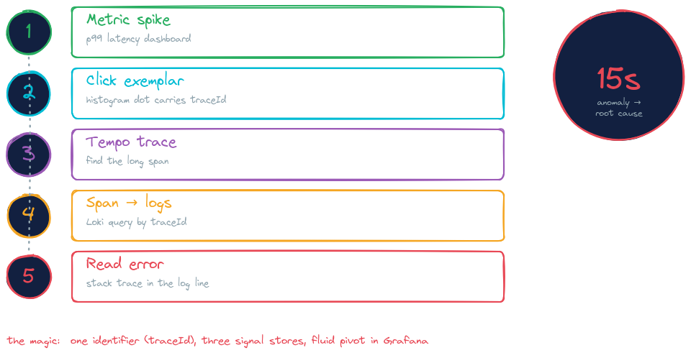
Demo 01
Three Signals, One Story
Three Signals, One Story
7
Notes:
Setup for Demo 01. The simplest demo, but it's the foundation everything else builds on. Key concept: trace_id is a 128-bit identifier. The agent generates it for the inbound HTTP request and propagates it down through the call stack. Logback's MDC picks it up. Micrometer attaches it to metric exemplars. What you're going to see: I hit the service with a single curl. Then in Grafana I find a slow trace in Tempo. From the trace, I jump to the logs for the same trace_id with one click. From the logs, I jump to a metric chart showing the same request's latency. If this works, we have a unified observability platform. If it doesn't, we're back to grep across servers. Time: ~10 min.

Slide 11
→ LIVE DEMO 01
cd demo-01-three-signals && ./demo.sh
Switch to terminal · run the demo · come back when done
Notes:
LIVE DEMO. Estimate: 4 minutes. Demo flow: 1. `./demo.sh` brings up the service + lgtm + Collector. Wait for green checkmarks. 2. Hit `/api/hello` 3-4 times in the terminal. Show response. 3. Open Grafana (localhost:3001). Show the dashboard. 4. Pick a trace in Tempo. Show the span tree. Highlight trace_id. 5. Click "Logs for this trace" → Loki shows correlated log lines. 6. Click on a metric exemplar dot → jumps back to the trace. If something fails: - Service didn't come up: `podman logs demo01-app | tail -30` - Grafana datasource red: wait 60s, refresh; provisioning is async - No traces yet: send 5 more requests, the Collector batches Fallback: pre-recorded screencap on USB stick if everything is on fire. [SCREENSHOT placeholder: Grafana trace view with logs panel below — backup in case the live demo fails.]

Slide 12
Recap — Demo 01
Correlation is a feature you build into the platform — not a query you run.
Each signal is more valuable when it shares context with the others
trace_id is the universal join key across traces, metrics, and logs
OTel agent or SDK both work; agents trade overhead for zero code change
The Collector is where you decide what survives the trip
Three Signals, One Story
9
Notes:
After the live demo, take 30 seconds here to anchor the takeaway: correlation is a *platform* property. You can't bolt it on after an incident. Foreshadow Demo 05: the agent that made all this work has a runtime cost we'll measure later. Foreshadow Demos 02 and 03: the Collector that we just glossed over is where the next two demos live. Time: ~14 min.

Slide 13
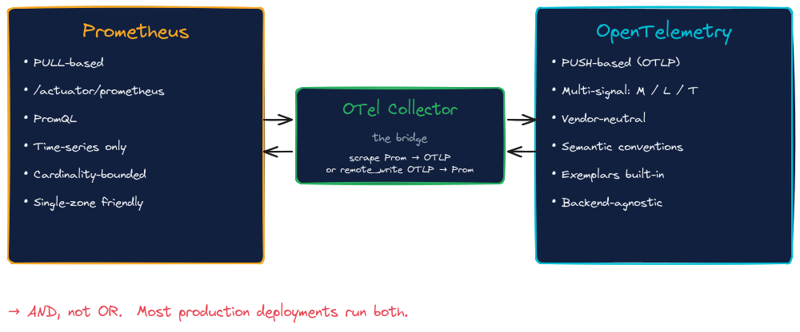
OpenTelemetry and Prometheus
Three Signals, One Story
10
Notes:
Question I get every time I give this talk: "But we already use Prometheus — does OpenTelemetry replace it?" Short answer: no. Long answer is this diagram.
Prometheus is a pull-based time-series database with a battle-tested query language and a model that fits single-zone deployments well. It's also cardinality-bounded, which Demo 02 in a moment makes very real. Most teams have years of PromQL muscle memory and dashboards built on it.
OpenTelemetry is push-based via OTLP, multi-signal — metrics, logs, and traces — vendor-neutral, with semantic conventions that travel across services. Different model, different strengths.
The OTel Collector is the bridge. It can scrape your existing Prometheus endpoints and translate to OTLP, or accept OTLP and "remote_write" ("write metrics out to a Prometheus-compatible storage backend") to a Prometheus-compatible TSDB. Both directions work.
The right framing isn't "OTel vs Prometheus" — it's AND, not OR. Most production deployments run both. The Collector lets them coexist.
Time: ~13 min (~1 min for this slide).

Slide 14
Demo 02
The Cardinality Bomb
Adding a label looks free. It isn't.
Each unique label combination is a separate time series
user_id as a label = unbounded series count = OOM the TSDB (time series database)
Watch a service emit ~100 series, then ~10,000
Show the Collector's transform processor stripping high-card labels
Three Signals, One Story
10
Notes:
Demo 02 setup. The trap: you have a metric `http_requests_total`. You add a label `user_id` because it sounded useful in standup. Now your metric has one time series per user. Active users? That's your series count. TSDB falls over at 10M series; many fall over at 1M. What we'll see live: an app that emits a metric with bounded labels (~100 series). Then we flip a feature flag that adds user_id as a label. Watch series count climb in real time. Then we watch the Collector's `transform` processor strip the offending label before it reaches Mimir. Same problem, fixed at the right architectural layer. Time: ~14 min.

Slide 15
→ LIVE DEMO 02
cd demo-02-cardinality && ./demo.sh
Switch to terminal · run the demo · come back when done
Notes:
LIVE DEMO. Estimate: 3-4 minutes. Demo flow: 1. `./demo.sh` brings up the stack and starts low-card load (100 unique requests). 2. Show Mimir's series count metric: ~100 series. Stable. 3. Send a `POST /toggle-user-label` to flip the feature flag. 4. Send 10,000 requests with unique user IDs. Watch series count climb. 5. Mimir starts complaining about scrape limits. 6. Apply the Collector config that strips `user_id` label. Reload. 7. Series count plateaus. Crisis averted. Pacing: drive sustained traffic for 90+ seconds before pivoting. Internal scrape interval is 60s — need 2 samples for rate() to look right. [SCREENSHOT placeholder: Mimir series count graph showing the climb-and-plateau pattern.]

Slide 16
Recap — Demo 02
Cardinality is the ops cost of metrics. Budget it like compute.
User-supplied values (user_id, request_id) belong in traces, not metric labels
Bucket continuous values (latency → quantile) before exporting
Use the Collector's transform/filter processors to enforce limits at the edge
Build alerts on series count growth — catch the bomb before the OOM
Three Signals, One Story
12
Notes:
Recap. The lesson is architectural, not technical: high-cardinality data is for traces, where it's queryable. Metrics are for aggregates. The Collector pattern matters: enforce the limit at the edge of your platform, not in the storage layer at 3 AM. Time: ~18 min.

Slide 17
Demo 03
Tail Sampling
Head sampling is cheap. Tail sampling is correct.
Head sampling: decide at trace start (no context yet)
Tail sampling: decide after the trace completes (full context)
Sample slow requests at 100%, fast successful ones at 1%
Configured in the Collector's tail_sampling processor
Three Signals, One Story
13
Notes:
Demo 03 setup. The problem: at scale you can't keep every trace. Head sampling ("keep 10% randomly") is cheap but stupid — you might drop the slow requests and keep all the fast ones. Tail sampling waits until the trace completes, then decides based on properties: was it slow? Did it error? Did it touch a sensitive endpoint? Keep all the interesting ones, drop a fraction of the boring ones. The cost: tail sampling needs the full trace in memory. The Collector buffers spans for 30-60 seconds. That's the trade-off. Time: ~18 min.

Slide 18
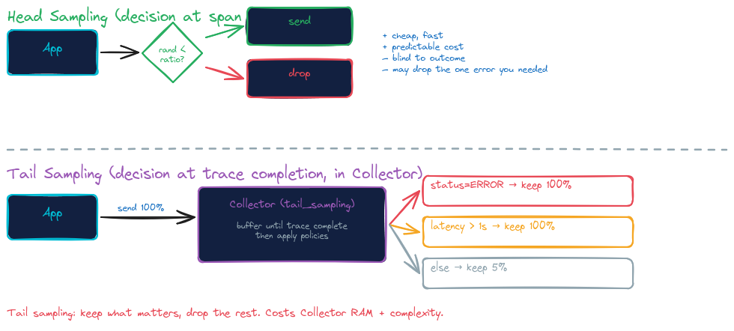
Demo 03
Head vs Tail Sampling
Three Signals, One Story
13
Notes:
The fundamental question of sampling: when do you decide what to keep?
Head sampling decides at the start, before the trace even runs. The application generates a random number, compares it to a configured ratio, and either keeps the trace or drops it. It's cheap, predictable, and stateless. The downside is in the diagram: it's blind to outcome. You might drop the one error trace you needed to debug an incident. Random sampling treats every request as equal, but in production, slow and erroring requests are more valuable than fast successful ones.
Tail sampling moves the decision to the Collector, after the trace has completed. The application sends 100% of traces. The Collector buffers each trace until all spans arrive, then applies policies: keep all errors, keep all slow requests, keep a small percentage of the rest. The cost is Collector RAM and configuration complexity, but the policies are smart.
The production answer at the bottom of the diagram is what most teams converge on: probabilistic sampling at the app to prevent the Collector from drowning, plus tail sampling at a Collector gateway to make smart decisions about what survives. Layered, not either-or.
Demo 03 shows the tail sampling pattern in isolation. Watch for: traces appearing 30-60 seconds after they complete, because the Collector is buffering. That's the trade-off in action.
Time: ~17 min (~1 min for this slide).
The bottom line is a real takeaway, not a throwaway. "parentbased_traceidratio at app + tail_sampling at Collector gateway" is a layered approach that combines both — the app does cheap probabilistic sampling on its own (so the Collector isn't drowning in 100% of every trace), and the Collector does smart policy-based filtering on whatever survived. This is a more nuanced position than "head bad, tail good" which a lot of OTel introductions simplify to. I'll make sure the speaker notes preserve this nuance — it's exactly the kind of practitioner-grounded content the CFP rewards.
The "5%" and "1s" are specific values from the demo's own config. Unlike diagram 09's "5-10%" — which was a generic claim about agent overhead — these numbers are operational policy choices documented in the actual collector-config.yaml. They're not contested or environment-dependent. They're saying: "here's what our demo configures." I'd leave them in the diagram. The speaker notes will frame them as "configurable policies" without implying they're universal.
Note 1 — "parentbased_traceidratio" is jargon. The diagram includes it because it's the OTel SDK config name. Audience members who haven't done sampling work won't recognize it. The speaker notes call it "probabilistic sampling at the app" instead — accessible, accurate enough.
Note 2 — the "30-60 seconds" buffer window. This is environment-dependent (Collector config, trace duration distribution). I included it generically in the speaker notes because it's something the audience will observe during the demo and might wonder about. If you want to soften that, change "30-60 seconds" to "tens of seconds".

Slide 19
→ LIVE DEMO 03
cd demo-03-tail-sampling && ./demo.sh
Switch to terminal · run the demo · come back when done
Notes:
LIVE DEMO. Estimate: 3-4 minutes. Demo flow: 1. `./demo.sh` brings up Collector with tail_sampling configured. 2. Show the policy in collector-config.yaml: 100% slow + errors, 1% fast successes. 3. Run load: 95% fast/successful, 5% slow or erroring. 4. Tempo trace count: total ingested vs. total kept. 5. Spot-check that all the slow traces are present, and ~1% of fast ones. Watch the latency: traces appear in Tempo ~30s after they complete (the buffer window). Don't pivot too fast or it looks like nothing's happening. [SCREENSHOT placeholder: Collector dashboard showing total received vs. total exported, with the policy decision breakdown.]

Slide 20
Recap — Demo 03
Sample for what's interesting, not what's typical.
Tail sampling needs the full trace in memory before it can decide
Latency, error status, and route are the most useful sampling axes
The sample rate per-policy is independent — keep all errors, 5% of OK
Trade-off: tail sampling adds 30-60s latency before traces appear
Three Signals, One Story
15
Notes:
Recap. The mental model: the Collector becomes a circuit breaker for your observability data. You decide what survives. The application doesn't have to know. Time: ~22 min.

Slide 21
Demo 04
JVM Metrics & GC Stories
Every garbage collector has a fingerprint.
Heap, GC pauses, thread count — all visible via Micrometer + OTel
Three GC sweeps: Shenandoah, G1, ZGC under matching load
Pause-time profiles look distinct on a dashboard
Spring Boot 4 metric names match OTel semantic conventions
Three Signals, One Story
16
Notes:
Demo 04 setup. JVM metrics are the test case where observability moves from "nice to have" to "how do you debug production at all." What we'll show: same app, same load, three different garbage collectors. Each leaves a different shape on the dashboard. You can identify the GC from the chart without being told. Why it matters: GC choice is an operational decision that you can verify with telemetry. Don't pick a GC because of a blog post; pick it because you measured it in your environment. Time: ~22 min.

Slide 22
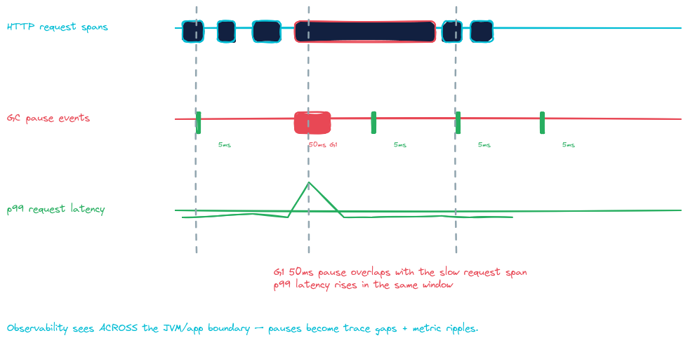
Demo 04
GC Pauses as Trace Gaps
Three Signals, One Story
16
Notes:
The diagram's structure (a timeline of HTTP request spans, with GC pause events overlaid, and a latency chart underneath) is showing the same wall-clock window through three signals at once. The 50ms G1 pause sits in the middle of an HTTP span, and the p99 latency line ticks up at exactly that moment. Cause-and-effect made visible.
"Observability sees ACROSS the JVM/app boundary" — this is what unified observability is. GC happens below the application; HTTP requests happen above; tracing is the only signal that can show you the seam between them.
The "5ms" repeated four times with one "50ms G1" in the middle is the diagram's most powerful visual move. Four normal requests, one slow one. The slow one isn't slow because the application is slow — it's slow because the JVM stopped the world. Without the GC overlay, this would look like a random latency spike. With it, the cause is obvious.
Stay with this diagram for a moment — it's doing more work than it looks.
Three signals stacked on the same timeline. The top row is HTTP request spans — five requests, four of them around 5 milliseconds, one of them suddenly 50 milliseconds. Without context, that fifth request looks like a random latency spike. The application code is identical. The database call is identical.
The middle row tells you why. A G1 garbage collector pause happened during that exact request. Stop-the-world. The JVM paused everything for 50 milliseconds, and the request thread paused with it. The application didn't get slower. The runtime stopped.
The bottom row shows the consequence at the metric layer — p99 latency ticks up in the same window.
One event. Three signals. Each shows it differently.
This is what unified observability buys you: visibility across the JVM-application boundary. GC isn't application code, but it absolutely affects application latency. Without the JVM signal layer, that 50-millisecond request is a mystery. With it, the cause is obvious before the alert page goes out.
Demo 04 shows this on real dashboards under three different garbage collectors. Each leaves a different shape. Once you've seen the shapes, you can read your own dashboards.
Time: ~22 min (~1 min for this slide).

Slide 23
→ LIVE DEMO 04
cd demo-04-jvm-metrics-shenandoah && ./demo.sh
Switch to terminal · run the demo · come back when done
Notes:
LIVE DEMO. Estimate: 4 minutes. Demo flow: 1. `./demo.sh` runs the same app three times, swapping the GC flag each time. 2. After each run, Grafana dashboard shows: heap usage, GC frequency, pause durations. 3. Side-by-side comparison panel at the end. 4. Point out the visible differences: G1 has occasional 50-100ms pauses, Shenandoah and ZGC stay under 10ms. Pre-restart Grafana 60+ seconds before showing the dashboard — provisioning is async after the container reports started. Hard browser refresh (Ctrl+Shift+R) after switching dashboards — Grafana caches panel definitions. [SCREENSHOT placeholder: Three-GC comparison dashboard at end of demo, showing distinct pause profiles.]

Slide 24
Recap — Demo 04
GC choice is an operational shape choice, not a tuning afterthought.
Shenandoah and ZGC keep pauses under 10ms even on multi-GB heaps
G1 trades occasional 50-100ms pauses for higher throughput
Fingerprint your service: which pause profile fits SLO budget?
On JDK 21+ on UBI, Shenandoah is one flag away: -XX:+UseShenandoahGC
Three Signals, One Story
18
Notes:
Recap. The point is empirical: don't guess about GC. Measure. Note for accuracy (we verified this in prep): UBI9 OpenJDK ergonomically picks G1 by default on every variant we tested (17, 21, 25; both builder and runtime). Shenandoah is *available* — Red Hat compiles it in — it's just not selected by JVM ergonomics. One flag activates it. Time: ~26 min.

Slide 25
Demo 05
Cold Start: What Telemetry Costs
The Java cold-start problem.
Why Java is slow to start
Project Leyden's promise
Classloading: parse, verify, link bytecode
JIT warmup: profile, recompile hot paths
Framework init: bean discovery, autoconfig
JPA: schema gen, entity scan, proxy gen
Agent: bytecode rewriting at startup
JDK 24+: pre-link classes (JEP 483)
JDK 25: AOT cache (JEP 514) — production-ready
Spring AOT: pre-compute bean factory
JPA repository AOT: parse queries at build
All compose into shorter cold start
Three Signals, One Story
19
Notes:
The problem: a typical Spring Boot app on JDK 21 took 5-8 seconds to boot. That's fine for long-running services, but it's an eternity for serverless or scale-from-zero workloads. Project Leyden is the JDK's response. Started years ago, productized in JDK 24/25. The big shipped feature is JEP 514 — AOT cache. Cache classloading work and JIT profiles to disk during a training run; reuse them at startup. Spring Boot 4 also has its own AOT layer that pre-computes bean factory state at build time. Combined, they should reduce startup substantially. We're going to measure exactly how much. Time: ~26 min.

Slide 26
AOT Cache Pipeline (JDK 25 + Spring Boot 4)
Four stages, one Containerfile, ~120 MB cache
1. Build
2. Extract
3. Cache
4. Runtime
mvn package
java -Djarmode=tools extract
java -XX:AOTCacheOutput \
-Dspring.context.exit=onRefresh
java -XX:AOTCache=app.aot
Spring Boot fat JAR
Flat layout
Train + write 120MB cache
Use cache, fast boot
Source: Piotr Minkowski's Spring Boot + Project Leyden writeup (Mar 2026)
Three Signals, One Story
20
Notes:
The pipeline. Four Docker stages. 1. Build: standard mvn package, produces Spring Boot fat JAR. 2. Extract: Spring Boot's tools jarmode unpacks the fat JAR into a flat layout. The JDK's AOT cache can't see classes inside nested JARs through Spring Boot's custom classloader — extracting first solves that. 3. Cache: boot the extracted app with -XX:AOTCacheOutput. Use spring.context.exit=onRefresh to exit cleanly right after Spring's bean factory is populated. That clean exit is what triggers the cache write. Result: ~120 MB binary cache. 4. Runtime: ship extracted layout + cache. Launch with -XX:AOTCache=app.aot. We landed on this design after a lot of trial and error. Piotr Minkowski's writeup from March 2026 was the breakthrough — the onRefresh trick is the key piece most online tutorials miss. Quarkus does this entirely differently — we'll get to that in two slides. [DIAGRAM placeholder: a fuller pipeline diagram showing the JVM that does the training match the JVM that runs the cache. We hit a real bug here where Temurin-trained caches were rejected by Red Hat OpenJDK at runtime.] Time: ~28 min.

Slide 27
→ LIVE DEMO 05
cd demo-05-aot-coldstart && ./demo.sh time-all
Switch to terminal · run the demo · come back when done
Notes:
LIVE DEMO. This is the headline. Estimate: 5 minutes. Demo flow: 1. `./demo.sh time-all` runs 24 cold starts (3 per variant, 8 variants). 2. Talk while it runs — explain what each variant tests: - Spring Classic + agent - Spring Classic + SDK telemetry (Spring Boot 4's new opentelemetry starter) - Spring Classic, no telemetry (control) - Spring AOT + agent - Spring AOT + SDK - Spring AOT, no telemetry - Quarkus baseline (no telemetry) - Quarkus + Leyden (no telemetry) 3. Final cross-framework table prints automatically. Pacing: this takes ~10 minutes to run. Talk during the runs. Show the running terminal as the medians come in. The drama is the contrast between Spring Boot's slow Classic and Quarkus's tiny Leyden. If something fails: we have pre-recorded numbers in TALK-NOTES.md. The rebuild fallback is to skip live and go to the next slide with the pre-baked table.

Slide 28
The Cold-Start Cost of Telemetry
Spring Boot 4 + JDK 25, JPA-heavy app, median of 3 cold starts each
 | + Agent | + SDK | no telemetry
Classic JDK 25 | 4.7 s | 4.0 s | 4.0 s
AOT cache | 4.3 s | 3.3 s | 3.3 s
Agent tax
SDK tax
AOT savings
~750 ms — runtime instrumentation cost
~30 ms — basically free
~700 ms (~18%) regardless of telemetry
Three Signals, One Story
22
Notes:
Money slide #1 — Spring Boot 4 telemetry comparison. Read the table left to right, top to bottom. Then the three callouts below. Key talking points: - Agent costs ~750ms regardless of whether AOT is on. This is consistent runtime instrumentation overhead. - SDK is essentially free. Spring Boot 4's new OpenTelemetry starter shipped November 2025; it's the modern answer. - AOT cache saves ~700ms (~18%). Real, measurable, but modest. Nothing like the dramatic numbers you may have read about. The 18% number is honest. AOT cache speeds classloading. JPA initialization is mostly post-classloading work — connection pool setup, schema introspection, entity metamodel. AOT can't accelerate any of that. This is the realistic Spring Boot 4 production picture. Now — same JDK, same Leyden flag, different framework. Watch what happens. Time: ~32 min.

Slide 29
Same JDK. Same Leyden. Different Framework.
No-telemetry baseline — apples-to-apples cold start
Spring Boot 4
Quarkus 3.33
Classic
Classic
3954 ms
787 ms
+ AOT cache
+ Leyden AOT
3252 ms
181 ms
Spring Boot saves ~18% with AOT. Quarkus saves ~77%. Same flag. Same JDK.
Three Signals, One Story
23
Notes:
Money slide #2 — and the talk's actual punchline. Same JDK 25. Same -XX:AOTCache flag. Same Project Leyden underneath. Two side-by-side cards. Spring Boot 4: 3954ms baseline → 3252ms with AOT. Saves about 700ms, ~18%. Quarkus 3.33: 787ms baseline → 181ms with AOT. Saves about 600ms, ~77%. Two findings worth pausing on: 1. Quarkus's BASELINE is faster than Spring Boot WITH AOT. Quarkus, no flags, beats fully optimized Spring Boot at startup. 2. Same flag, very different leverage. The reason isn't Leyden — it's framework architecture. Spring Boot does its bean discovery, autoconfiguration evaluation, and JPA initialization at runtime. AOT cache only helps with classloading; the rest can't be cached. Quarkus does almost all of that at BUILD time. The application that boots is mostly pre-baked. AOT cache amplifies an already-fast startup. Takeaway: AOT cache is a JVM feature. How much it helps depends on what your framework does at startup. Your framework, not your vendor, is the cold-start lever. [OPTIONAL: 30s on the implications. If your workload is serverless, this picks the framework. If it's long-running, the agent tax disappears in 5 minutes anyway.] Time: ~33 min.

Slide 30
The agent tax doesn't amortize on cold scale.
Long-running services? Agent tax disappears in 5 minutes. Use the agent.
Serverless / scale-from-zero? 750ms is your entire startup budget. Use the SDK starter.
Match your telemetry to your workload's startup sensitivity.
Notes:
The conclusion of Demo 05. Big text, dark slide — let it breathe. This is where I hand the audience an actual decision-making framework, not just numbers. The agent vs SDK question used to be theological — "agents are easier, SDKs are cleaner." Now it's empirical: the agent costs about 750ms, the SDK is free. That cost matters or it doesn't, depending on whether you cold-start often. Long-running services: 750ms doesn't matter. The agent's runtime overhead is also negligible after warmup. Use the agent. Less code change. Serverless / scale-from-zero / cold-scaling Kubernetes: 750ms is everything. Use the SDK starter. Modernize your tooling. And if cold-scale really matters, look at Quarkus. Same Leyden, 4x the leverage. Time: ~34 min. Heading into close.

Slide 31
Three Things to Take Home
1
Correlation is a feature, not a query.
Build trace_id propagation into your platform. Across signals, across services, across processes. Without it, every observability question becomes archaeology.
2
Cardinality is an ops cost. Budget it.
User IDs go in traces. Latency goes in histograms. Continuous values get bucketed. The Collector is where you enforce the budget at the edge — not the TSDB at 3am.
3
Match telemetry to workload sensitivity.
OTel agent for long-running services where the 750ms tax amortizes. SDK starter for cold-scale and serverless. Framework choice matters more than vendor.
Three Signals, One Story
25
Notes:
The summary. Three things you can take to your team Monday morning. Each takeaway maps to a demo: 1. Correlation: Demo 01 2. Cardinality: Demo 02 (and the principle from Demo 03) 3. Telemetry-to-workload: Demo 05 Don't read the long descriptions. Just announce the three titles and let the audience read the details. Confidence in delivery here is more important than coverage. Time: ~35 min.

Slide 32
Resources & References
This talk's code
github.com/patterncatalyst/otel-observability-demos
OpenTelemetry
opentelemetry.io
Spring Boot 4 OTel
spring.io/blog/2025/11/18/opentelemetry-with-spring-boot
Project Leyden
openjdk.org/projects/leyden
Grafana LGTM
github.com/grafana/docker-otel-lgtm
OTel Collector
github.com/open-telemetry/opentelemetry-collector
Three Signals, One Story
26
Notes:
Resources slide. Don't read the URLs. Just point to the repo URL at the top. "Everything I showed today is in this repo. Clone it, run any demo, send me a PR." [OPTIONAL: have a QR code for the GitHub URL. Many in the audience won't be able to type a URL from a slide while listening.] Time: ~35 min.

Slide 33
Questions?
Thank you.
[Speaker] · [Twitter/X · GitHub · email]
Notes:
Q&A. Common questions to anticipate: Q: "Doesn't GraalVM native image beat both of these?" A: Yes — for cold start. Native image is ~50ms. Trade-off: build is 5-10 min, no JFR, restricted reflection, no dynamic class loading. Different commitment level. If cold start is the only metric, go native. Q: "Why not use the OTel agent with Quarkus?" A: You can. Quarkus has native OTel support though — `quarkus-opentelemetry` extension. SDK approach with Quarkus's build-time wiring is the canonical pattern. Q: "What about Micronaut?" A: Same family as Quarkus — build-time wiring framework. I'd expect similar AOT cache numbers. Haven't tested, would love to see a PR with measurements. Q: "How representative is your JPA app?" A: It's a deliberate medium-weight app: H2 + 1 JPA repository + 6 entities + REST + actuator + scheduler. Smaller apps see less Spring Boot AOT savings; larger apps see more. Quarkus relative numbers are stable across app size. Q: "Does this matter for non-cold-start workloads?" A: Less so. The agent tax doesn't compound for long-running services. AOT cache memory savings (resident set size) are still real, but startup latency is the headline. If no questions: thank, repo URL, off.

Slide 34
Bonus
Shenandoah is one flag away on UBI
The story
How
Red Hat develops & maintains Shenandoah
Generational since JDK 21
Sub-10ms pauses on multi-GB heaps
Built into UBI9 OpenJDK — already there
JVM ergonomically picks G1 (we verified)
Switch with one JVM flag, no rebuild
# Shenandoah
-XX:+UseShenandoahGC
# G1 (default)
-XX:+UseG1GC
# ZGC (low-pause alt)
-XX:+UseZGC
Three Signals, One Story
28
Notes:
Bonus slide — only show if there's time and someone asks about GC. The honest framing: UBI9 OpenJDK ergonomically picks G1, on every variant we tested (17, 21, 25; both builder and runtime images). G1 is the JVM's default for server-class machines. Shenandoah is *available* — Red Hat compiles it in — it's just not selected by the JVM's ergonomics. One flag activates it. Worth knowing about for low-pause workloads. Don't use this slide if I'm tight on time. The Demo 04 recap covered the substance.

Slide 35
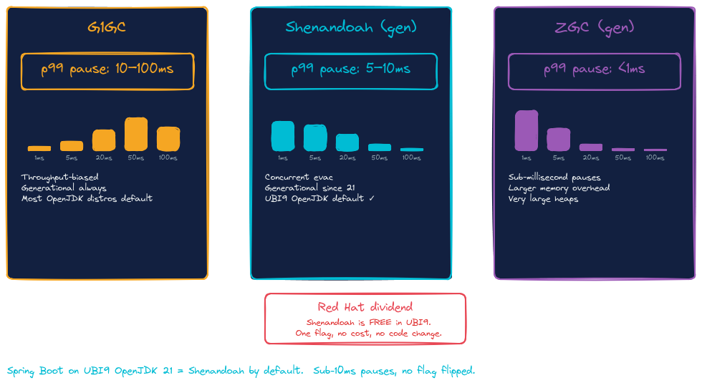
Bonus
Shenandoah is one flag away on UBI
Three Signals, One Story
28
Notes:
Bonus slide — only show if there's time and someone asks about GC. The honest framing: UBI9 OpenJDK ergonomically picks G1, on every variant we tested (17, 21, 25; both builder and runtime images). G1 is the JVM's default for server-class machines. Shenandoah is *available* — Red Hat compiles it in — it's just not selected by the JVM's ergonomics. One flag activates it. Worth knowing about for low-pause workloads. Don't use this slide if I'm tight on time. The Demo 04 recap covered the substance.

Slide 36
Bonus
Reproduce on your laptop
# Prereqs
Fedora 43+ / Mac OS, podman 5.x, JDK 25 (Temurin)
git clone github.com/patterncatalyst/otel-observability-demos
cd otel-observability-demos
# Run any demo end-to-end
cd demo-01-three-signals && ./demo.sh
cd demo-02-cardinality && ./demo.sh
cd demo-03-tail-sampling && ./demo.sh
cd demo-04-jvm-metrics-shenandoah && ./demo.sh
# The headline: 8-way cold start comparison (~10 minutes)
cd demo-05-aot-coldstart && ./demo.sh time-all
Three Signals, One Story
29
Notes:
Bonus slide — show only if there's time, otherwise it's in the repo README. The point: clone, cd, ./demo.sh. Five commands and you have everything I just showed running on your laptop. Common questions about prereqs: - Does it work on macOS? Probably; podman runs on macOS but I haven't tested. - Does it work on Windows? Probably with WSL2; not tested. - Why podman not Docker? Personal preference. The compose files should work in both.

Slide 37
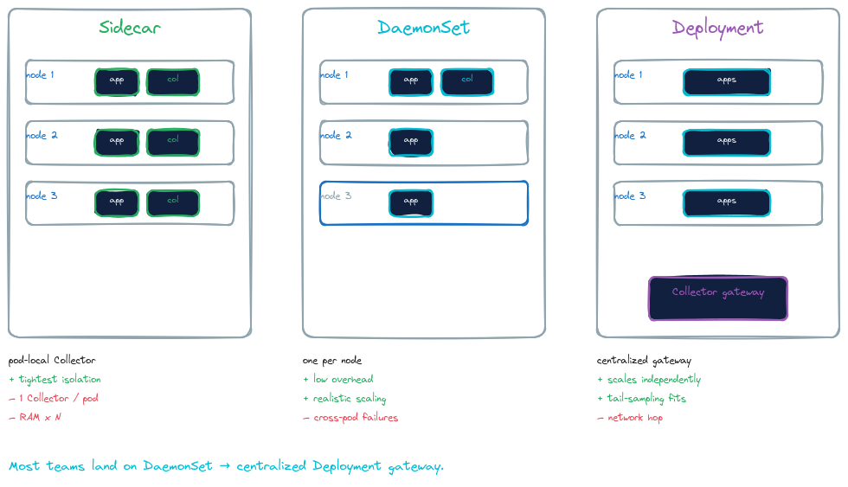
Bonus
Kubernetes Framing
Three Signals, One Story
29
Notes:
Bonus slide — show only if there's time, otherwise it's in the repo README. The point: clone, cd, ./demo.sh. Five commands and you have everything I just showed running on your laptop. Common questions about prereqs: - Does it work on macOS? Probably; podman runs on macOS but I haven't tested. - Does it work on Windows? Probably with WSL2; not tested. - Why podman not Docker? Personal preference. The compose files should work in both.

